Slide 1
Implementing Delivery Strategies with Argo CD and Kubernetes
Selvaraj Kuppusamy
DevOps Engineer
Grootan Technologies

Slide 2
Agenda
Traditional SDLC
DevOps
Commonly available CI/CD Tools
Microservices Deployment
Common challenges with traditional CI/CD Tools
Argo CD
Why Argo CD
GitOps Pattern
Core concepts
Application
Project
ApplicationSet, etc..
Demo

Slide 3
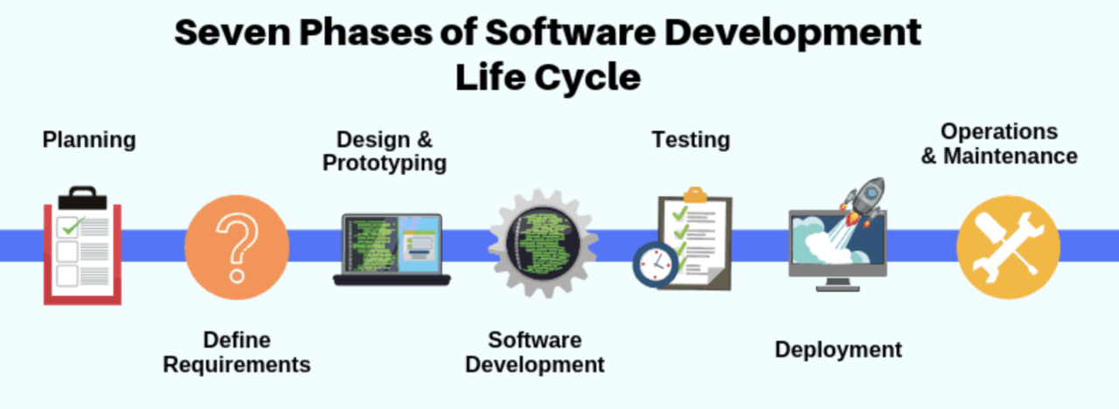
Traditional SDLC

Slide 4
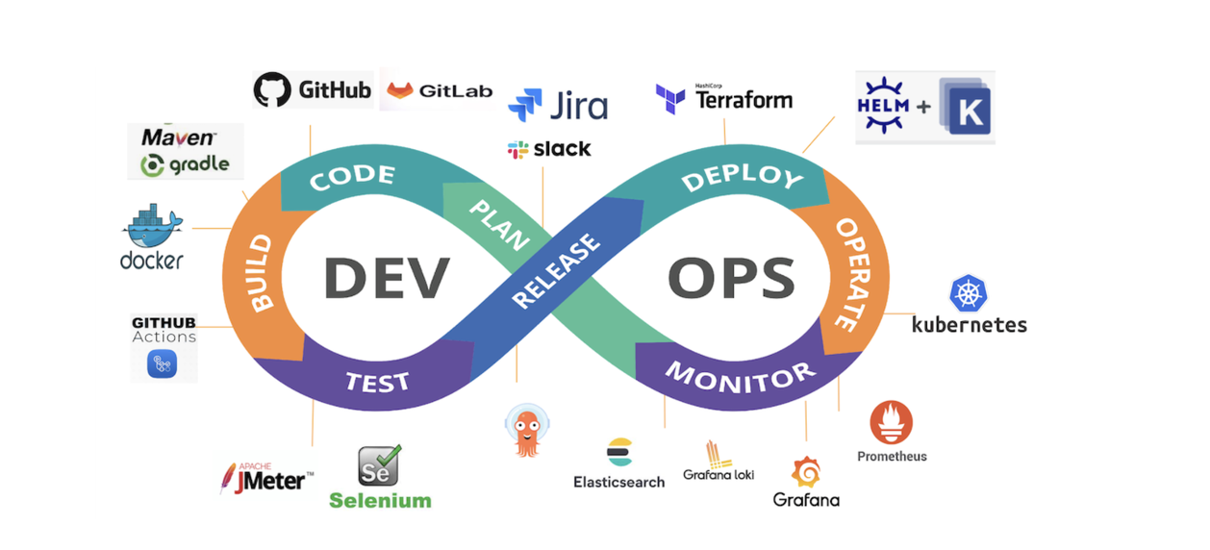
DevOps Lifecycle

Slide 5
Challenges with other traditional CD tools
Complex Configuration Management: Other CD tools may require complex scripting and manual setup of pipelines.
Limited GitOps Support: Many CD tools aren't GitOps-based, requiring manual intervention to track changes and maintain state.
Lack of Visual Representation: Tools like Jenkins, CircleCI, or GitLab CI/CD might not offer visual dashboards.
State Management and Rollbacks: Some tools have poor state management and limited rollback options compared to GitOps tools like Argo CD.

Slide 6
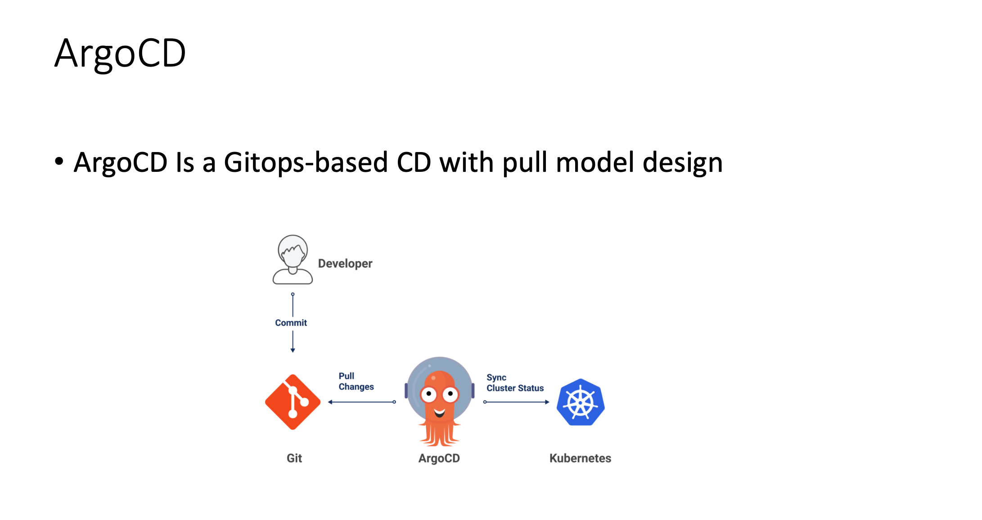

Slide 7
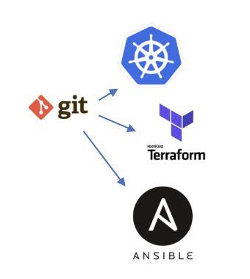
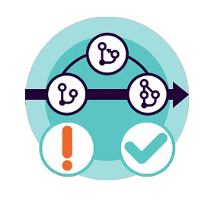

What is GitOps?
Infrastructure as Code, Configuration as Code
Collaboration + Change Mechanism (Code Review)
Continues Integration and Continues Delivery Pipelines

Slide 8
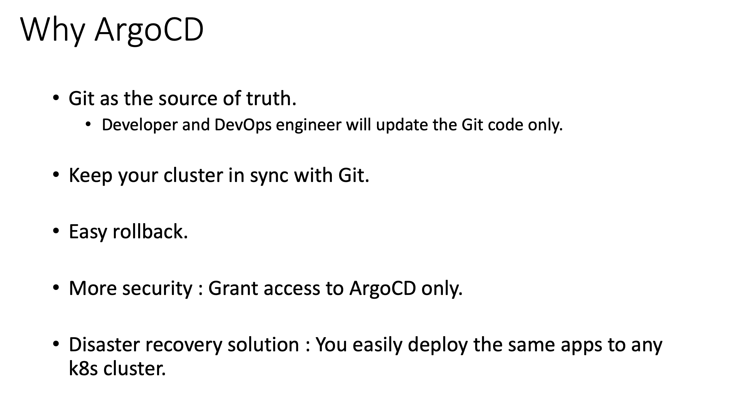

Slide 9
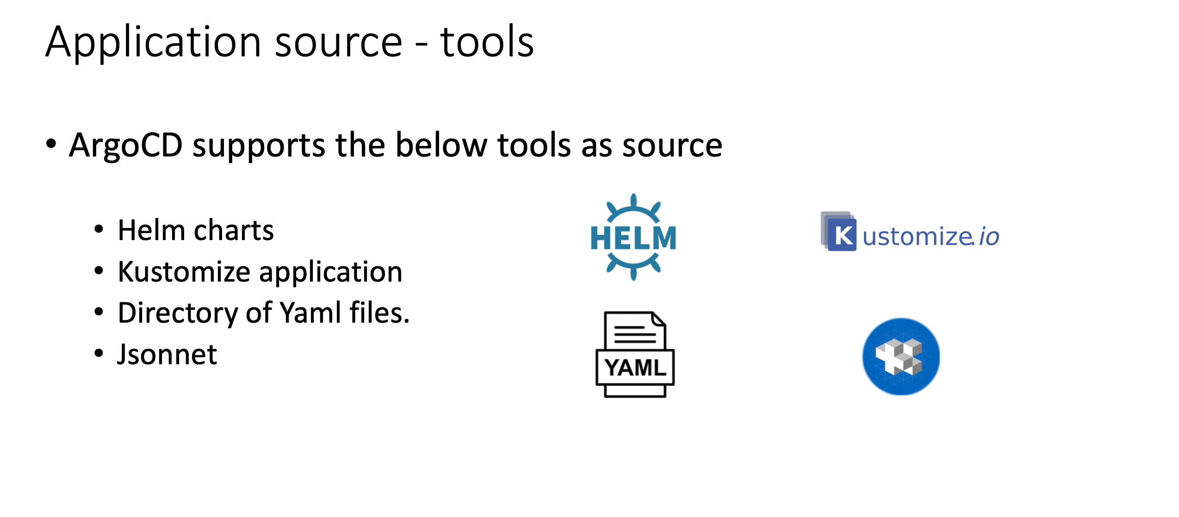

Slide 10


Slide 11
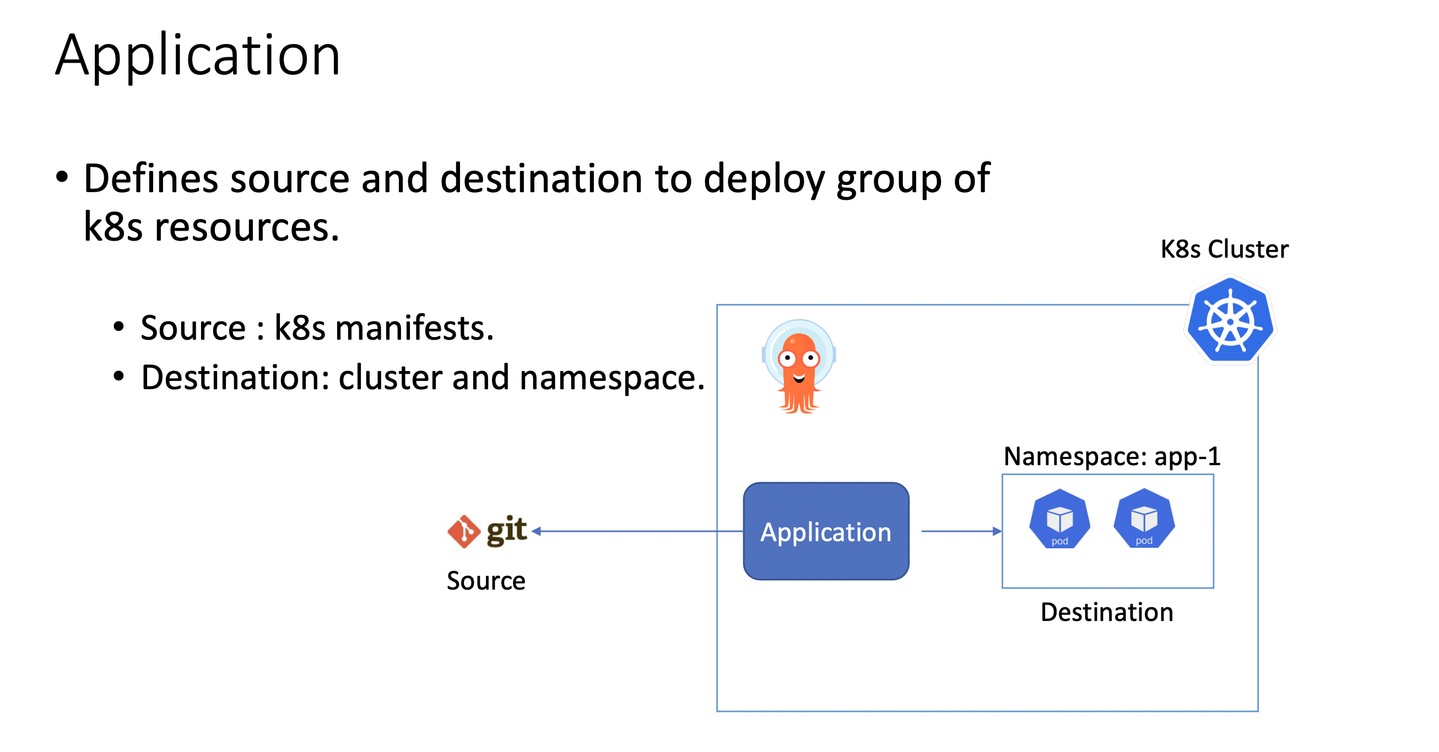

Slide 12
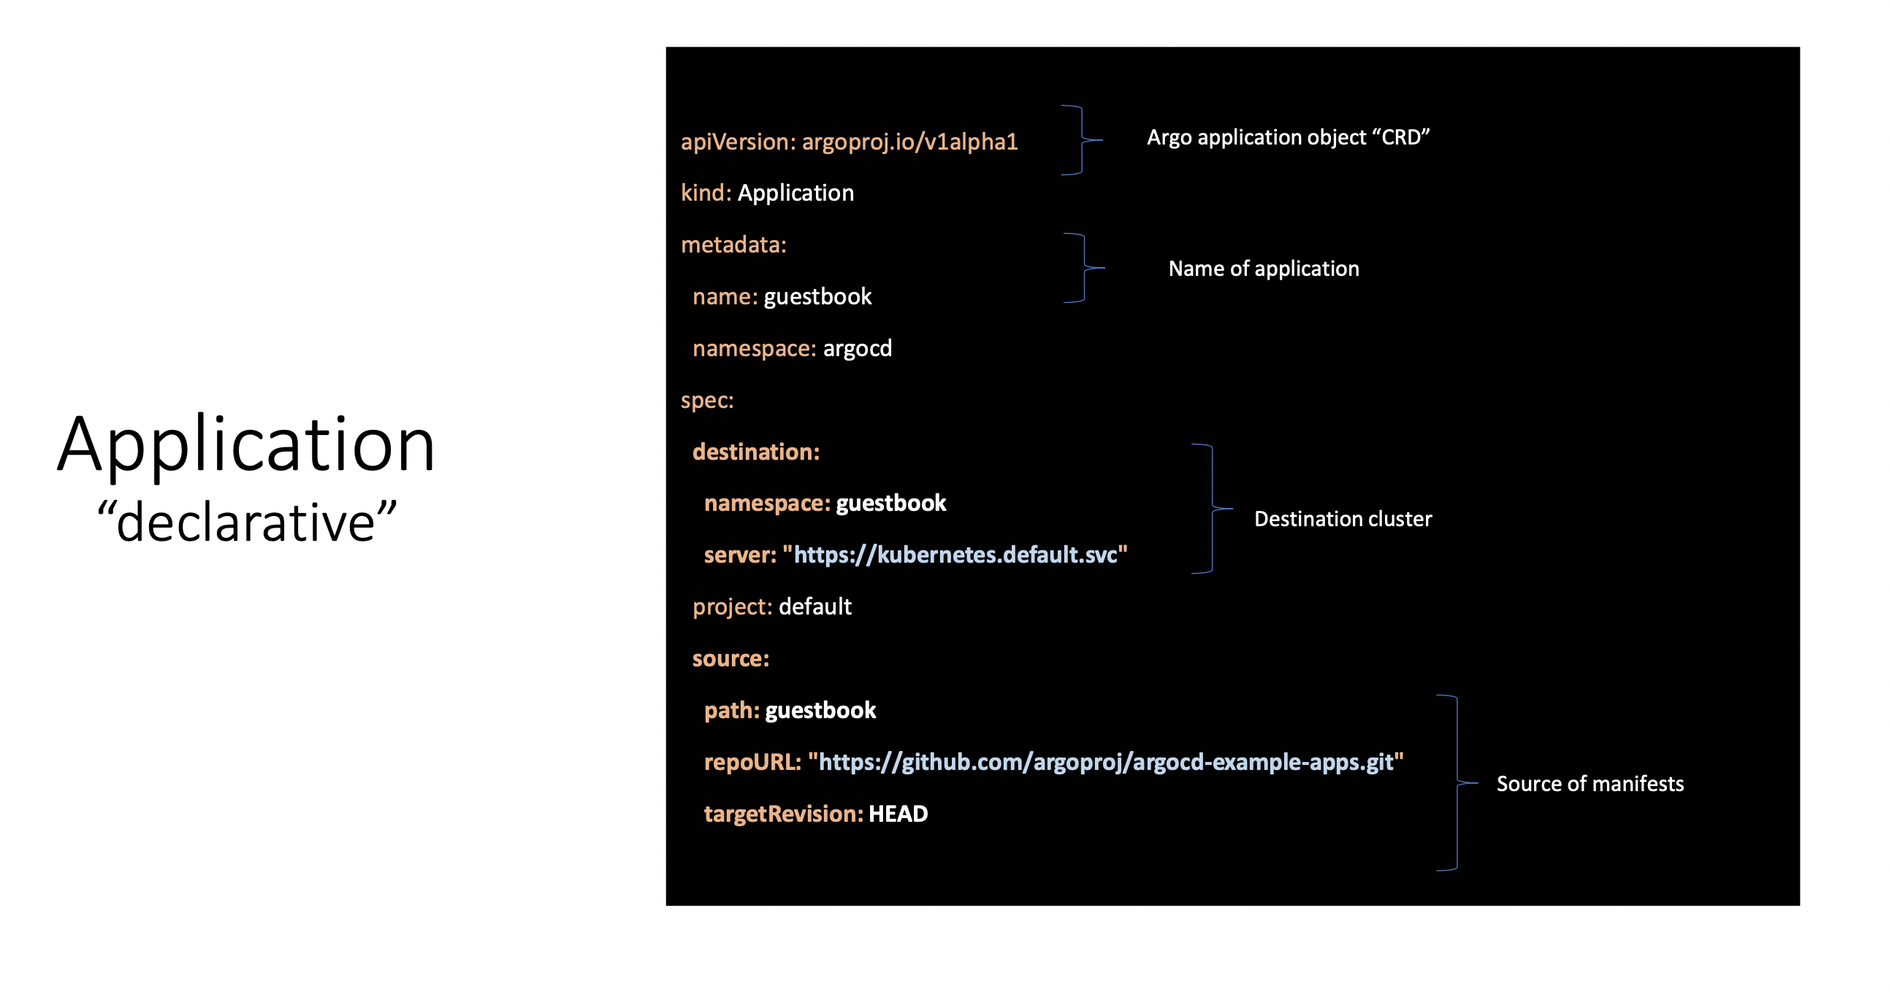

Slide 13
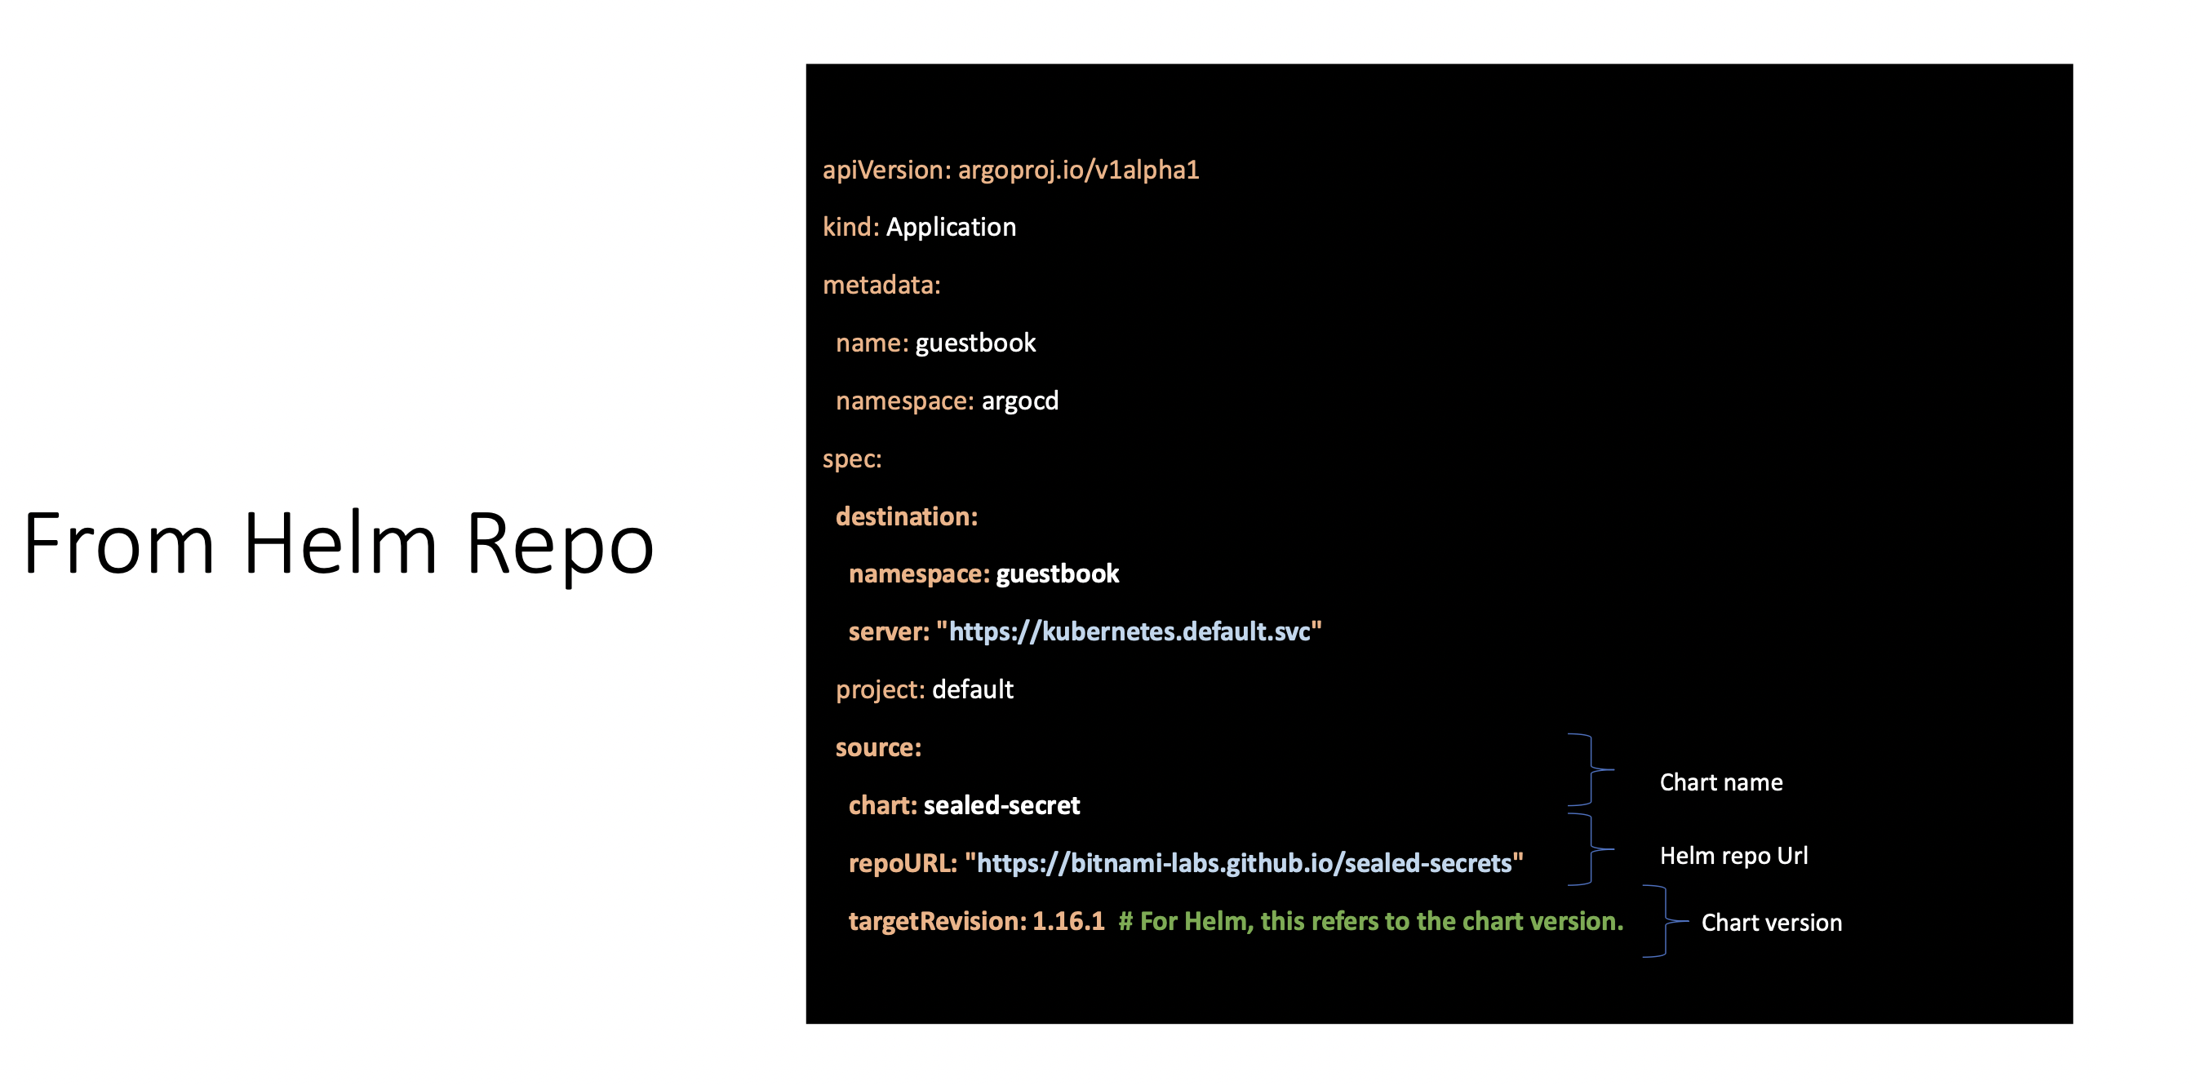

Slide 14
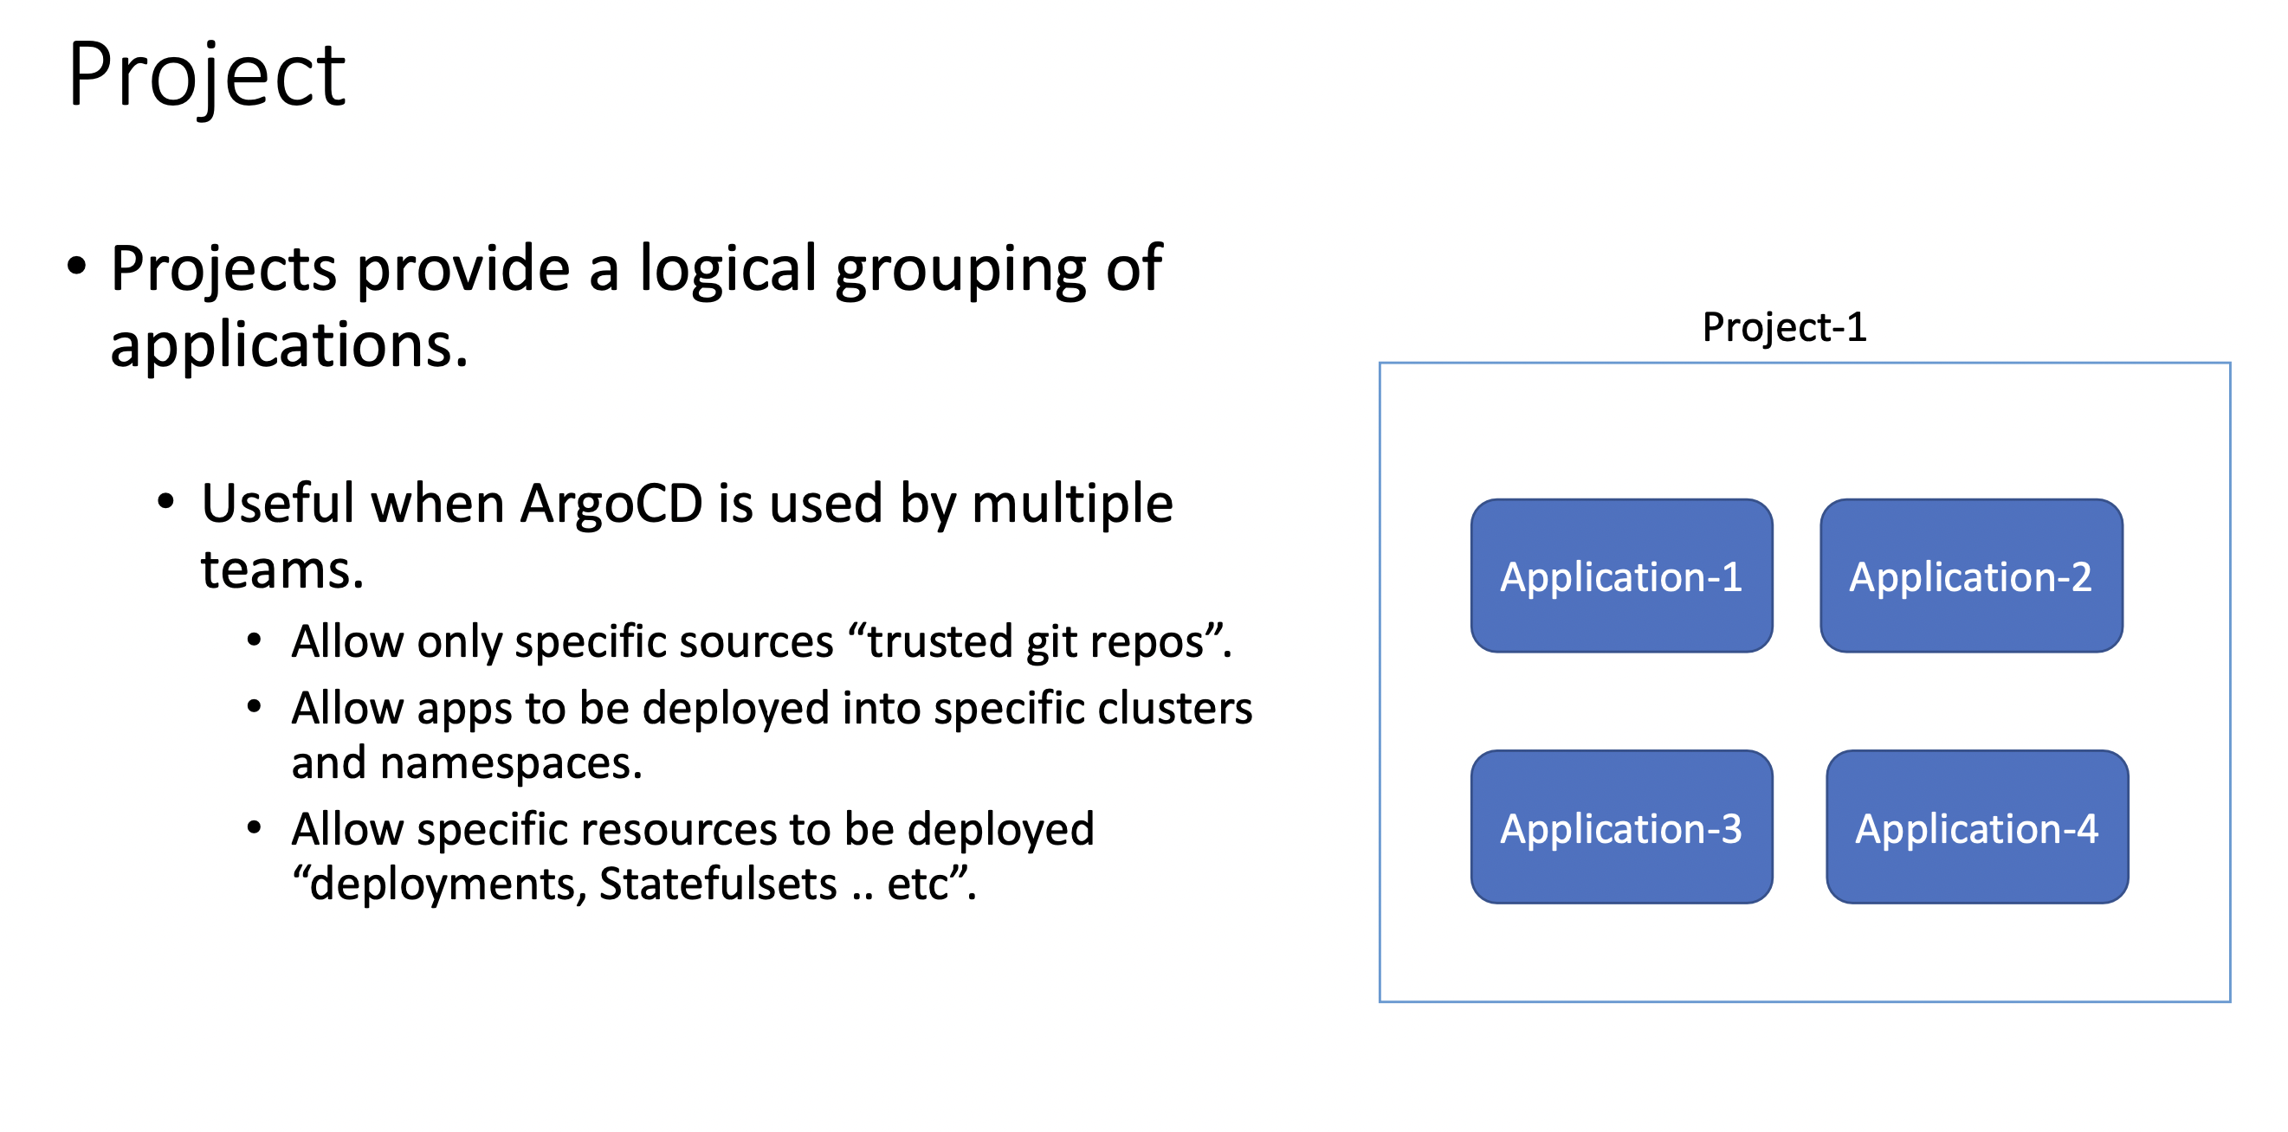

Slide 15
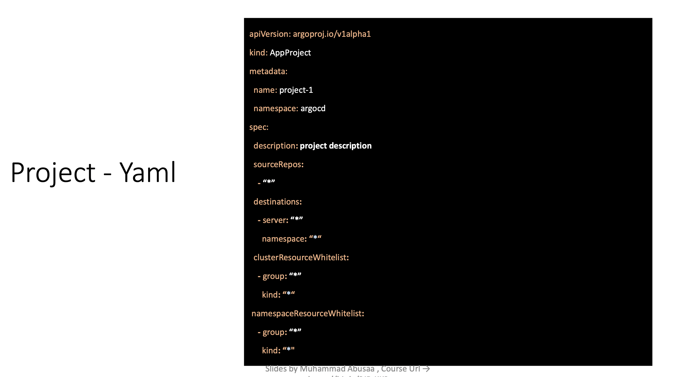

Slide 16
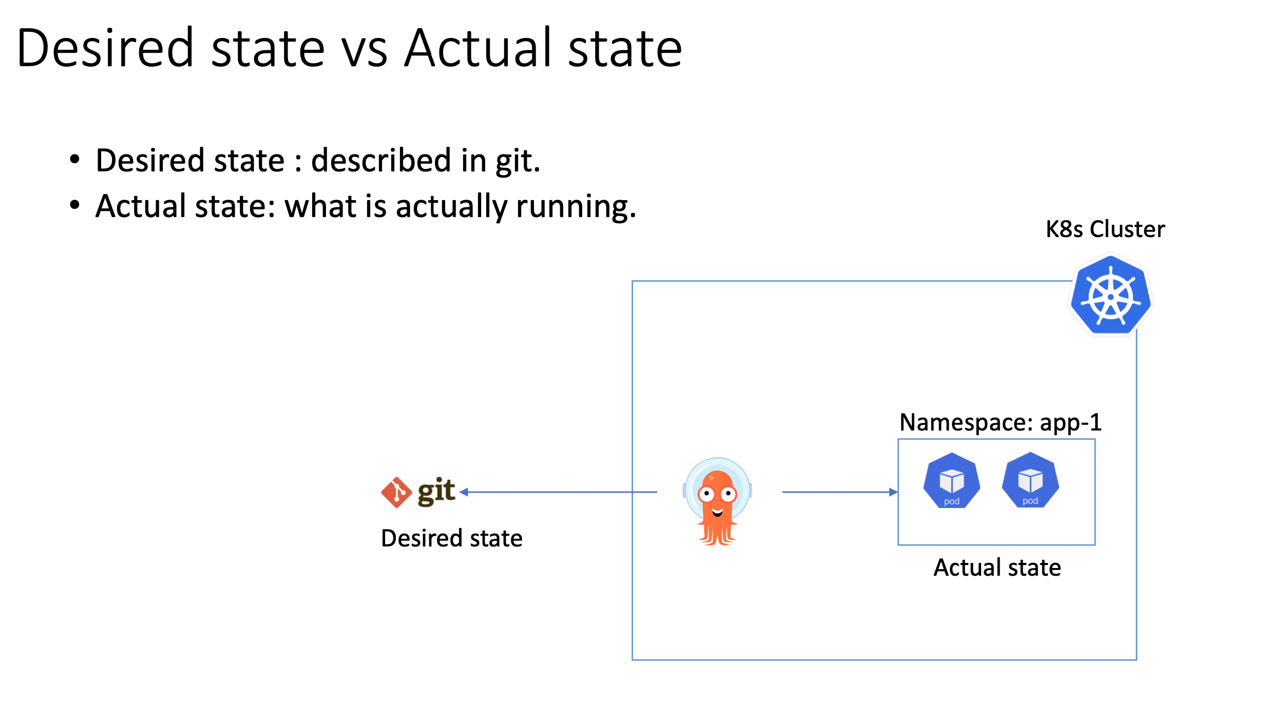

Slide 17
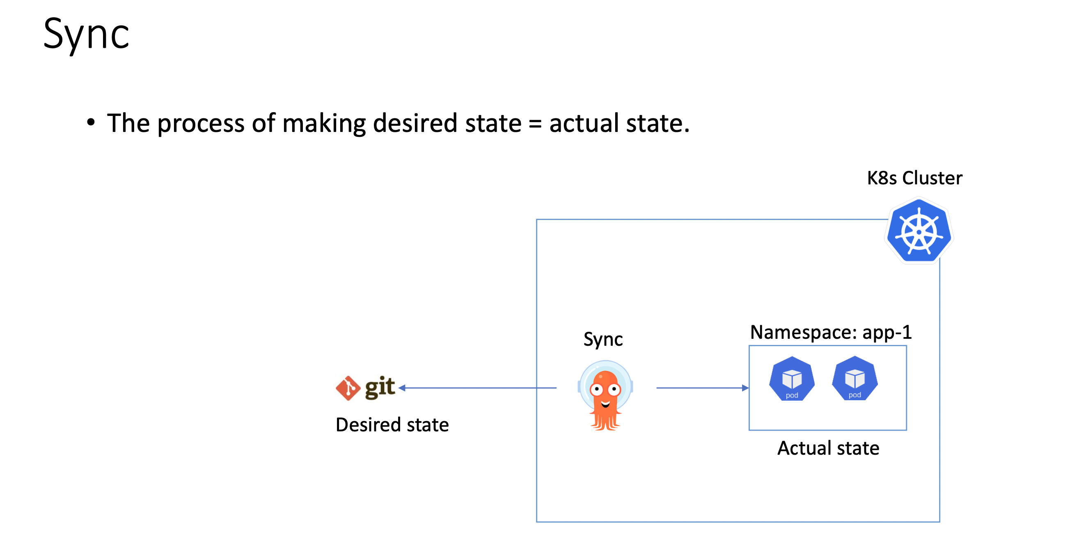

Slide 18
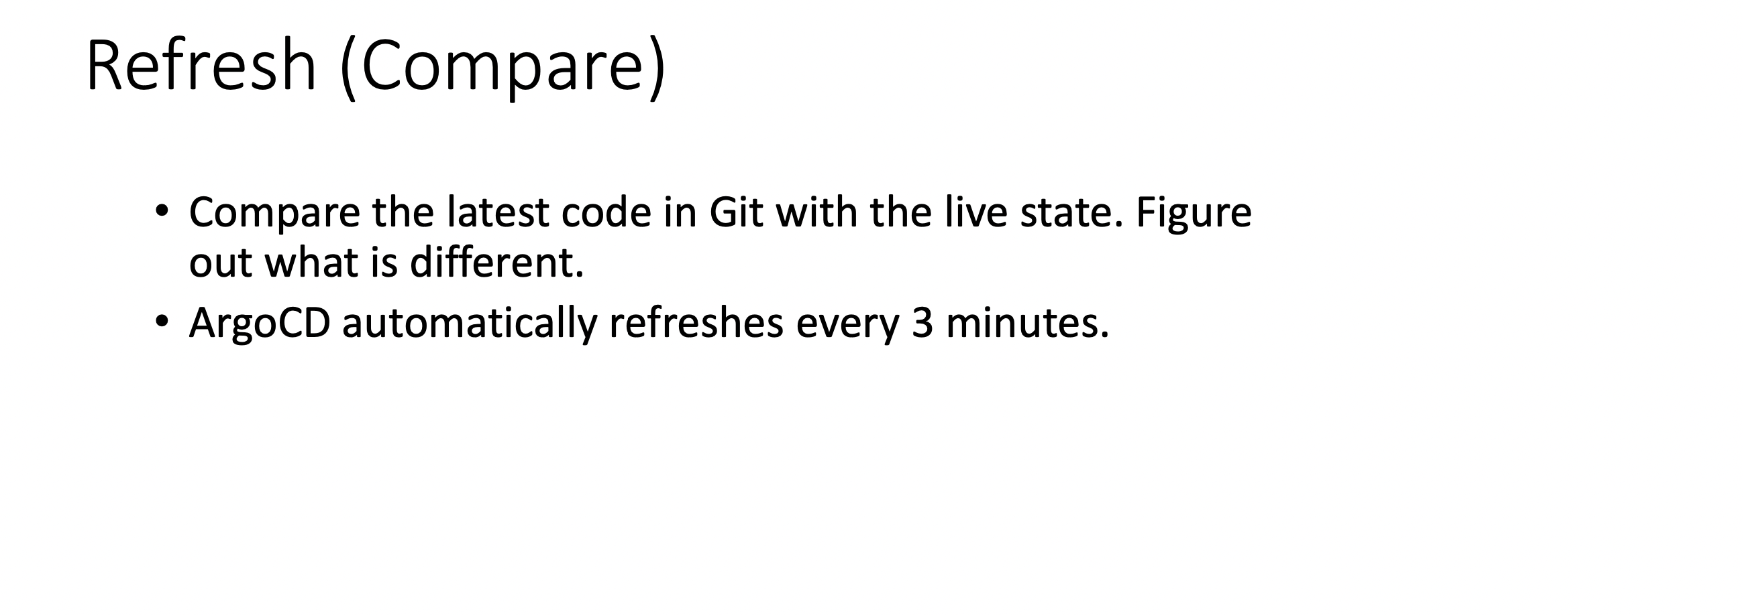

Slide 19
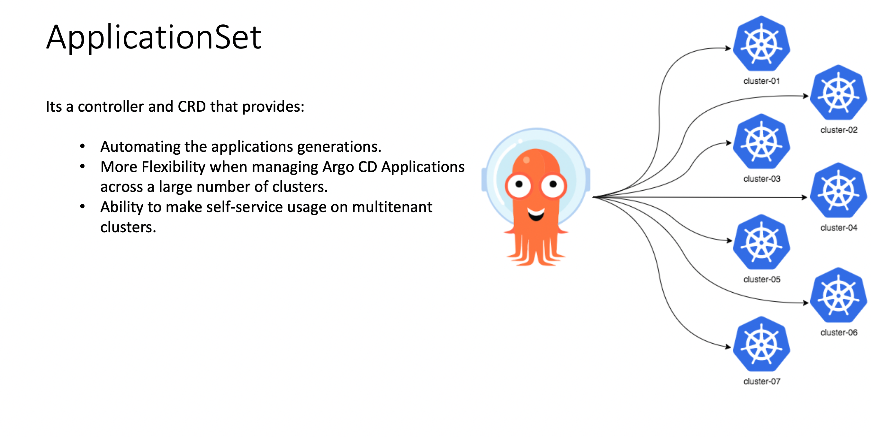

Slide 20
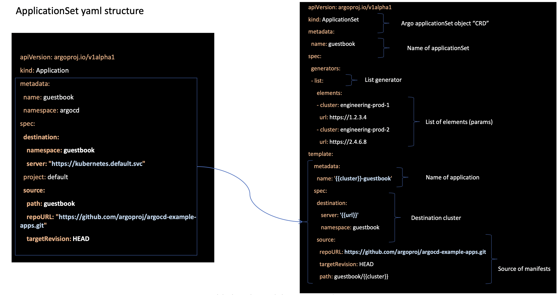

Slide 21
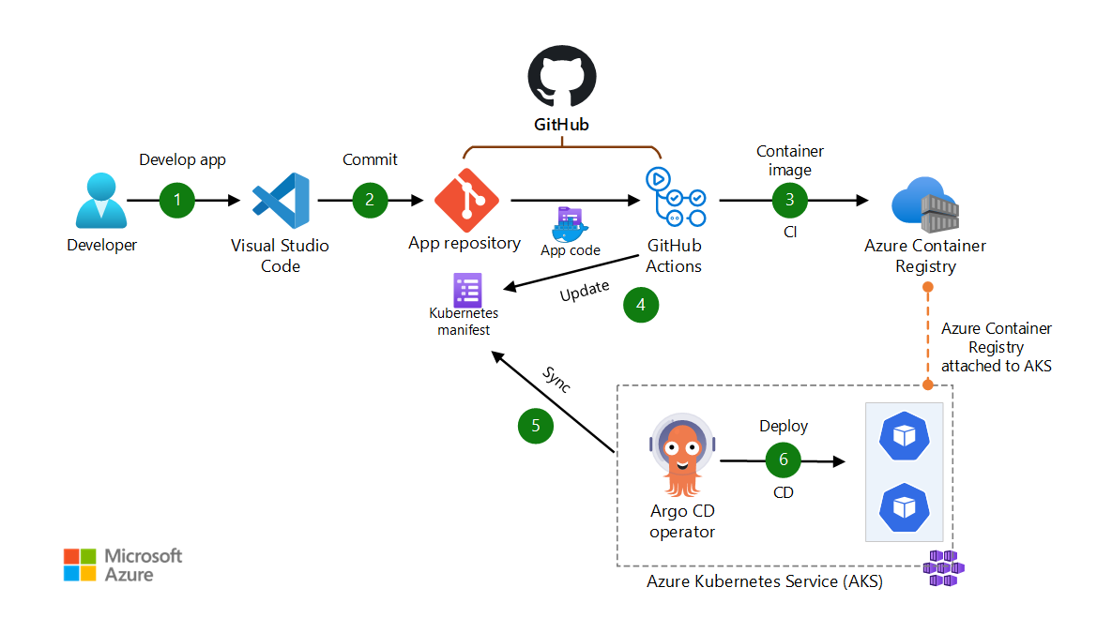
DevOps Workflow

Slide 22
Demo

